Slide 1
GMEM：面向领域加速器的通用内存管理
华为操作系统技术专家
朱维希
2023.10

Slide 2

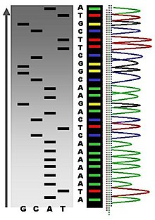



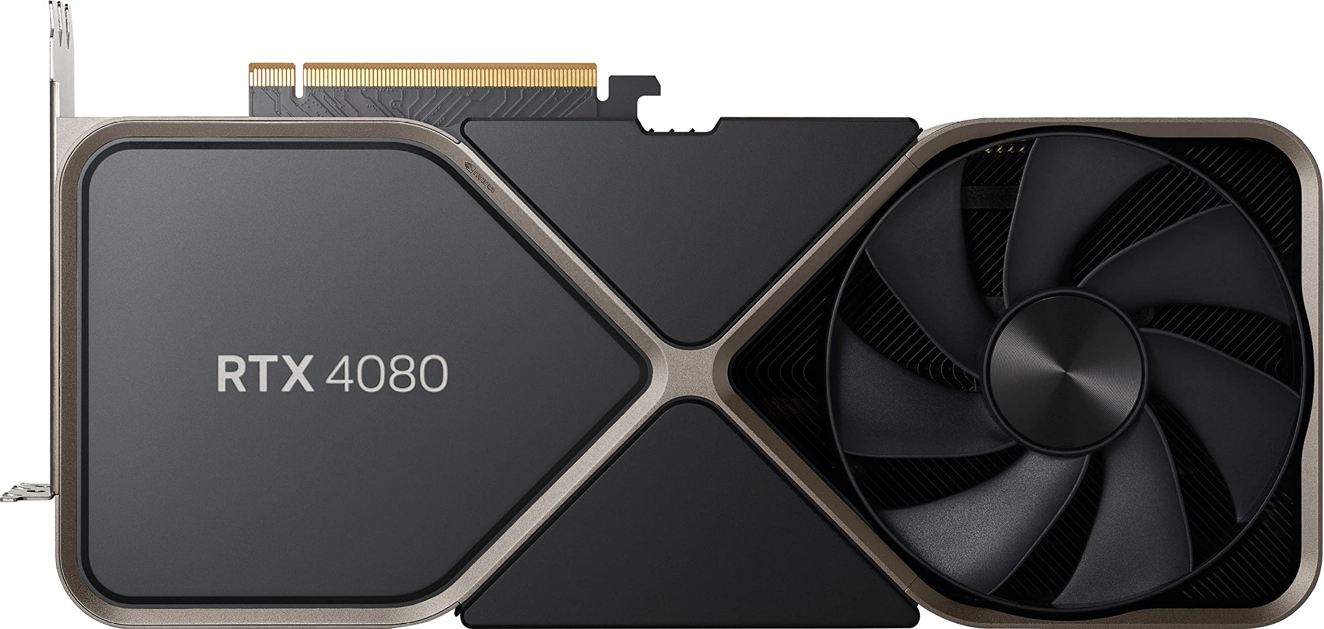
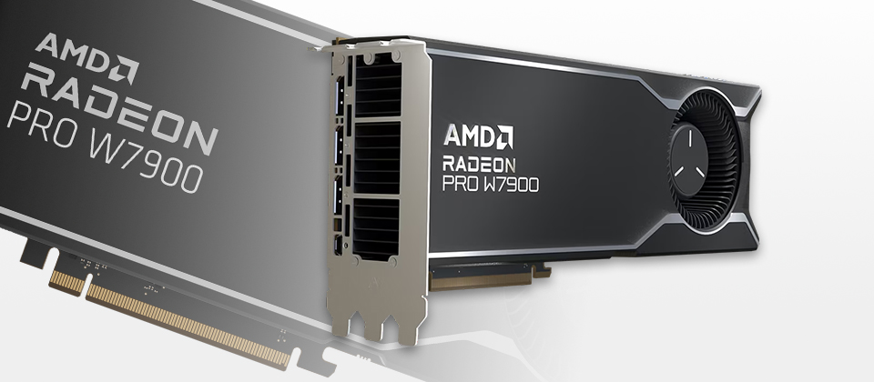
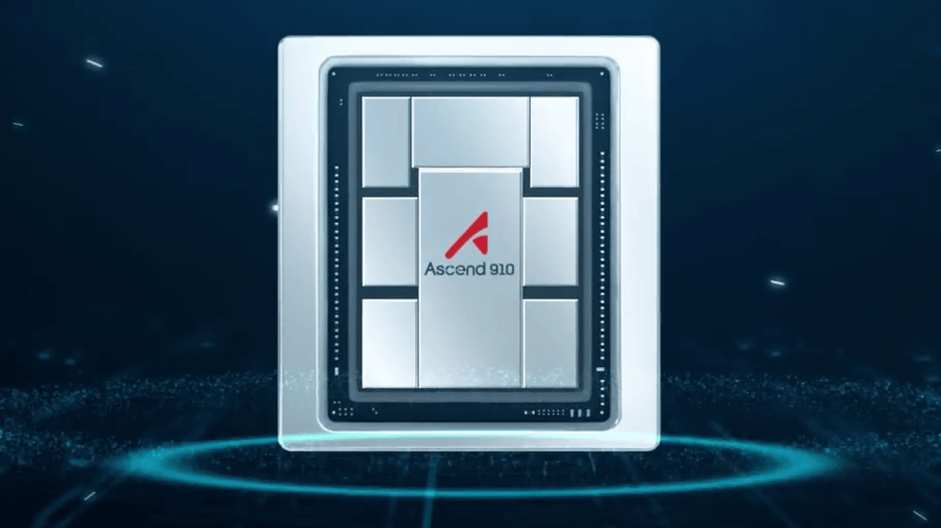
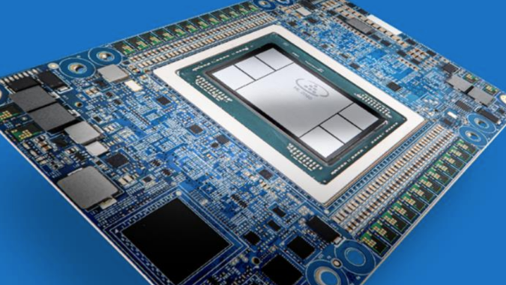
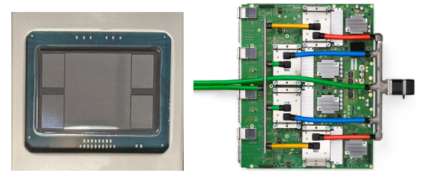
The golden age of accelerators
Powered by Accelerators

Slide 3


The heart of openEuler's OS for AI
GMEM: history and future
Originated from my PhD study at Rice Univ,
inspired by
a. Micro-arch opportunities;
b. OS design principles
Academic literature available:
GMEM: Generalized Memory Management for Peripheral Devices (arXiv:2310.12554 [cs.OS])
Prof. Scott Rixner
Prof. Alan L. Cox
Linux-based version soon available in openEuler 23.09 in early Oct, 2023

Slide 4
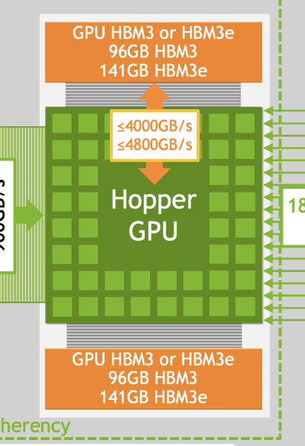

Memory is the core of AI Infra
AI/heterogeneous applications require
CPU coordination
Large memory capacity
Fast memory allocation
High memory utilization
4TB/s & 96GB
However, the reality...
Poor programmability : CPU buffer? GPU buffer?
OOM (Out-of-memory) : small HBM capacity
Slow “malloc/free” : not reinvented well
Memory Fragmentation : failed to malloc 500MB with 10GB free HBM!

Slide 5
The cost of reinventing “malloc”
CPU Apps
AI Apps
Do they work well?
Latency comparison (small sizes):
PyTorch vs. jemalloc:
1000ns vs. 300ns
tc/je/ptmalloc
AI framework
3x slower!
Device “Malloc” (#LoC) | User-level “malloc” | User-level swapping | Total
PyTorch | 3,650 | 2,509 | ~6K
TensorFlow | 2,228 | 1,557 | ~4K

Slide 6
The cost of reinventing mm subsystem
mmap/sbrk/
madvise
cudaMalloc/...
Linux core mm: 80K LoC
FreeBSD core mm: 30K LoC
OS
Device driver
Device MM (#LoC) | Core Device MM | Kernel-level Swapping | Total
Nvidia | ~34K | ~70K | ~104K
AMD | ~14K | N/A | ~14K
Huawei Ascend | ~30K | N/A | ~30K
Bugs?
System overhead?
Memory fragmentation?

Slide 7
Motivation of GMEM
Stop people from further reinventing the wheel
No more “malloc” for GPU, TPU, etc.
No more mm systems for device drivers
Enhanced programmability
Unified virtual address space / User-guided memory advice
Device memory oversubscription
Better memory service
Faster malloc/free speed
Higher memory utilization

Slide 8
Why can the OS manage *ANY*
accelerator’s memory?
Because MM subsystems are no different!
1. Virtual address allocation/deallocation
2. Physical address allocation/deallocation
3. VA-PA address mapping management
4. Physical data preparation (zero, copy, DMA)
Invoke hardware-specific handling

Slide 9
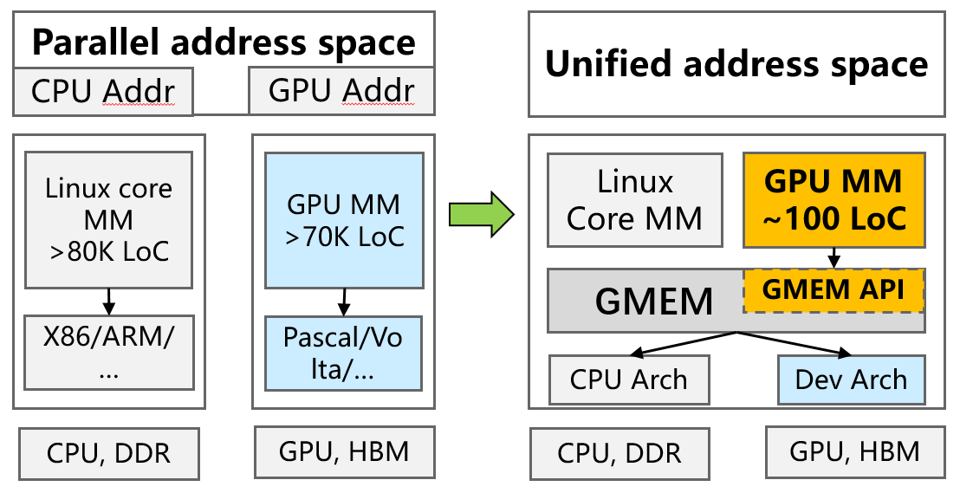
A high-level view of GMEM design
Only provide high-level APIs
Decouple low-level MMU handling
3. Require registering MMU functions
4. Coordinate multiple page tables within each address space

Slide 10
Why not Linux HMM?
TL;DR
HMM helps driver-Linux mm collaboration but cannot prevent reinventing one.
malloc
mmap, madvise
Linux MM
MMU notifiers: triggered by
Linux MM events
Implement your own accelerator’s MM!
4-layer page walk functions
handle_mm_fault: a better version
of get_user_pages)
x86
arm

Slide 11
Or just cache-coherent bus?
IBM P9-Volta bug:
OS falsely populates DDR pages when handling GPU page faults
CPU
Accelerator
CXL/NVLink/…
DDR
HBM
GMEM makes the OS aware of accelerator nodes
Data by default is preferably faulted on HBM
Provides memory hints for user’s proactive prefetch
Remote access / fault driven migration?

Slide 12
GMEM implementation
Unified virtual address space
mm_struct points to CPU, accelerator page table
Per-process logical page table for mapping coherence
GMEM maintains a coherent view of memory
Invoking MMU functions
Accelerator-specific
MM struct
Accelerator #1 attached
Accelerator #2 attached
VMA management
MMU functions
MMU functions
CPU page table
walker
Logical page table
Buddy allocator
GMEM mapping coherence

Slide 13
Key features of GMEM
Enhanced programmability
CPU and accelerator share virtual pointers
Transparent memory oversubscription
Waive OOM (out-of-memory) issue
Debloat redundant mm code
Waive driver’s mm development
Waive App’s malloc development
User-guided heterogeneous memory hints
Proactive data prefetches
Easy comp/comm overlapping

Slide 14
GMEM Evaluation

Slide 15
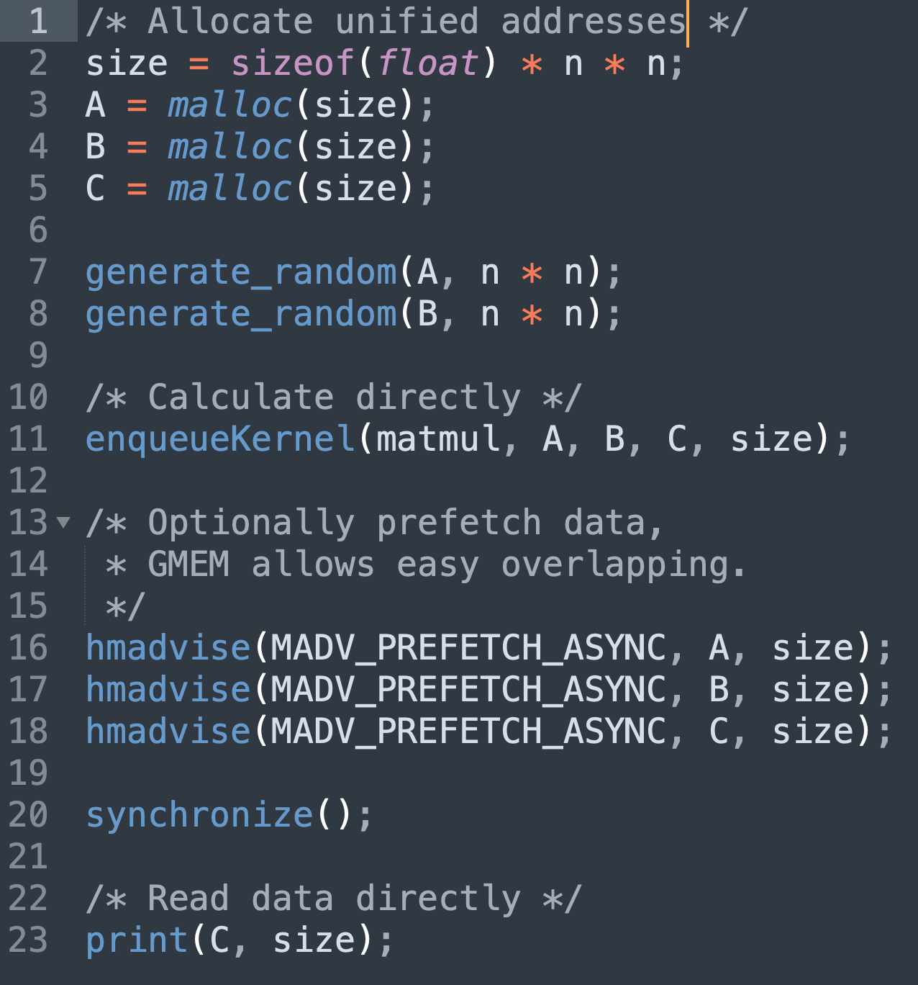
Programmability
Malloc pointers are sharable between CPU and accelerators.
Easy comp/comm overlapping:
Stream 1
Stream 2
Matmul kernel
Prefetch(A)
Prefetch(B)
Prefetch(C)
Synchronize (Barrier)
*Correctness is guaranteed by GMEM’s concurrent page fault mechanism.

Slide 16
MM/Malloc basic performance
Memory-sensitive Apps (redis, gcc) has <1% perf penalty with GMEM’s refactoring Linux MM
User-level | Avg. Latency
malloc (GMEM) | 300ns
PyTorch’s “malloc” | 1000ns
3x faster

Slide 17
OS code debloating
MM Systems | # LoC
Ascend NPU driver | 30,000
GMEM-based NPU driver | 30 (calling GMEM API) + 2000 (underlying MMU functions)
90% less code

Slide 18
Memory defragmentation
Protein folding prediction (an alphafold variant):
Problem size: 25% larger
End-to-end inference speed: 20%~40% (due to faster kernel compilation)
We are applying GMEM to enhance LLM inference throughput, stay tuned!

Slide 19
Transparent memory oversubscription
A 32GB NPU card was able to train a 52B LLM model,
with <10 LoC changes in the AI framework,
oversubscribing 1TB DDR, powered by GMEM.

Slide 20
Conclusions & future work
GMEM solves the wild growth of memory service code
Accelerator memory management – now Linux MM simply works
“Malloc” code in AI-platform – now any tc/je/whatever malloc works
The core of AI-infrastructure
Enhanced programmability: unified virtual address space
Faster malloc & Higher HBM util.
Alleviate OOM/Memory fragmentation
Transparent memory oversubscription
User-guided memory hints

Slide 21

Roadmap of open-sourcing
Call for contribution
Accelerator driver developers
Availability
Currently: preliminary code available
openEuler 23.09 (2023-Oct) – source code + documentation
openEuler 24.03 LTS (2024-Mar) – better extended
Please subscribe openEuler maillist ☺
SIG-compute: dev@openEuler.org
SIG-kernel: kernel@openEuler.org
Notes:
Sig组的邮件地址
Kernel组邮件列表

Slide 22
谢谢！

